Slide 1


Computational Fluid Dynamics (CFD) Research Project
Luke Peterson
Aerospace Engineering
Embry-Riddle Aeronautical University

Slide 2
Background
Issues of convergence time (cost)
Precision vs speed
Extending the reach of DNS
Cost scales at least as Re²
But the areas of high residual are highly localized.

Slide 3
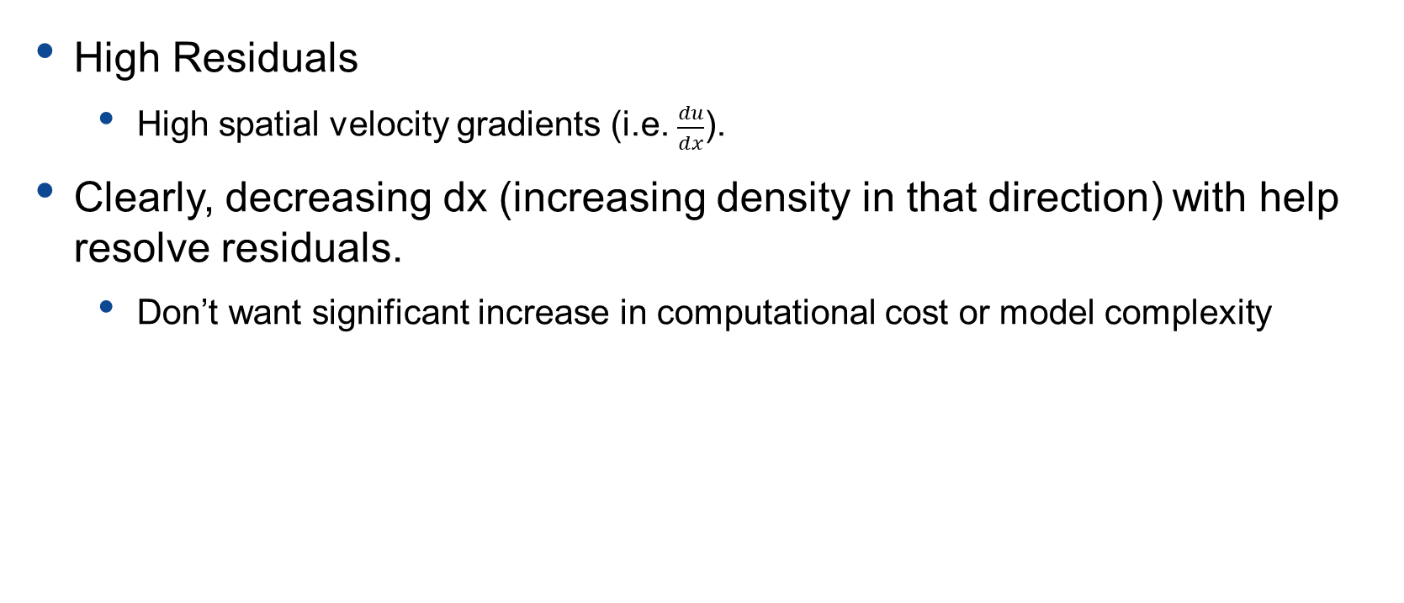
Our Problem
High Residuals
High spatial velocity gradients (i.e. $\frac{du}{dx}$).
Clearly, decreasing dx (increasing density in that direction) with help resolve residuals.
Don’t want significant increase in computational cost or model complexity

Slide 4
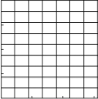

Common CFD Approaches
Increase uniform mesh density (N² ≥ Re)
High computational cost
[1]
[1]

Slide 5
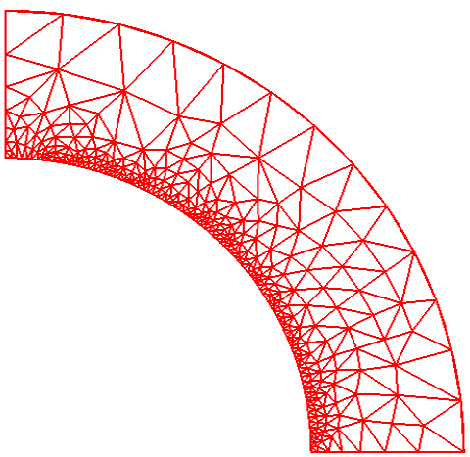
Common CFD Approaches
Biased/Skewed mesh density
Higher model complexity
Fewer grid points
More arithmetic operations per point
Increased memory lookups
[2]

Slide 6
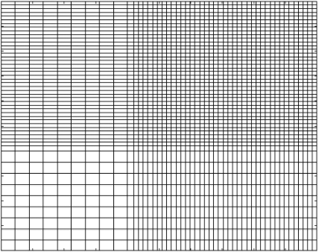
Common CFD Approaches
Multi-grid
Overall fewer points → lower computational cost
Increased model complexity and memory I/O cost
[1]

Slide 7
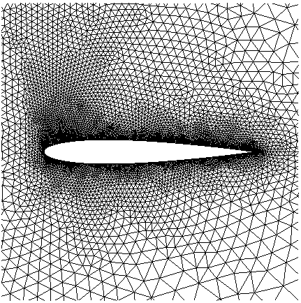
Common CFD Approaches
Unstructured grid
Highly capable for non-uniform geometry
Very costly in
Model complexity
Memory
Computation
[3]

Slide 8
Our Solution
Higher-density, dynamic-mesh around residuals
Increased resolution only around localized area of high residuals
Global mesh doesn’t see additional points
Minimal change in computational cost
Minimal increase in model complexity

Slide 9
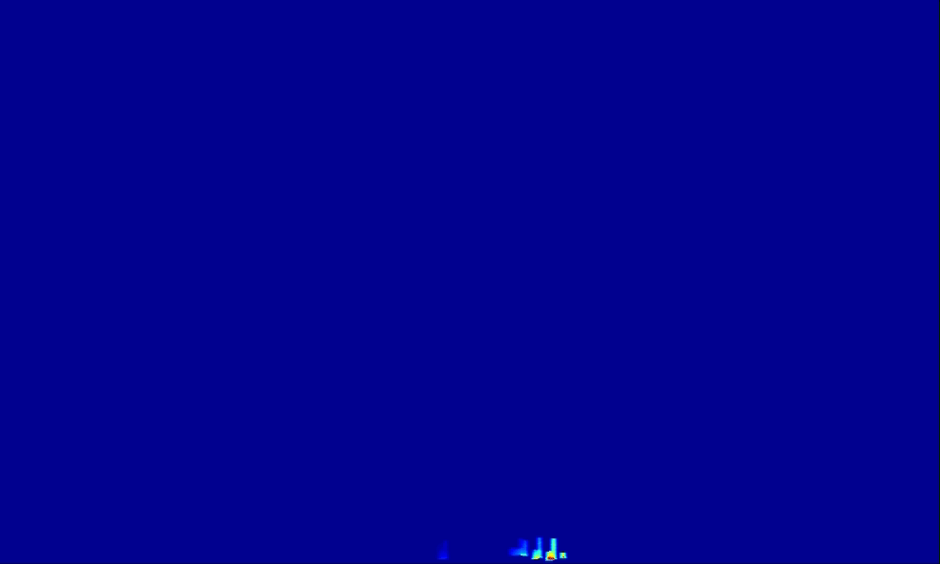
Our Solution
Residual field of x-velocity

Slide 10
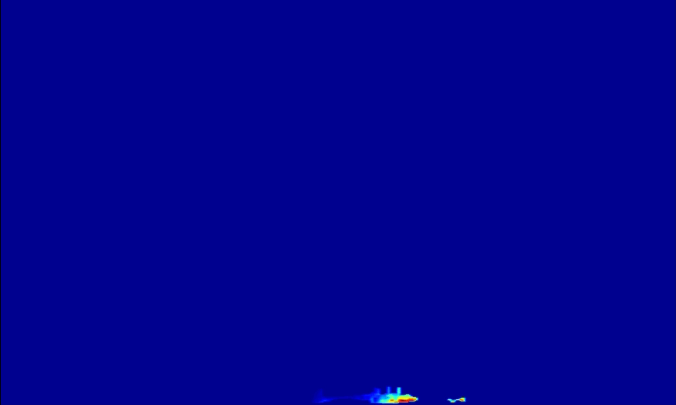
Our Solution
High residuals (O~10⁻⁵) restricted to a small area of the domain

Slide 11
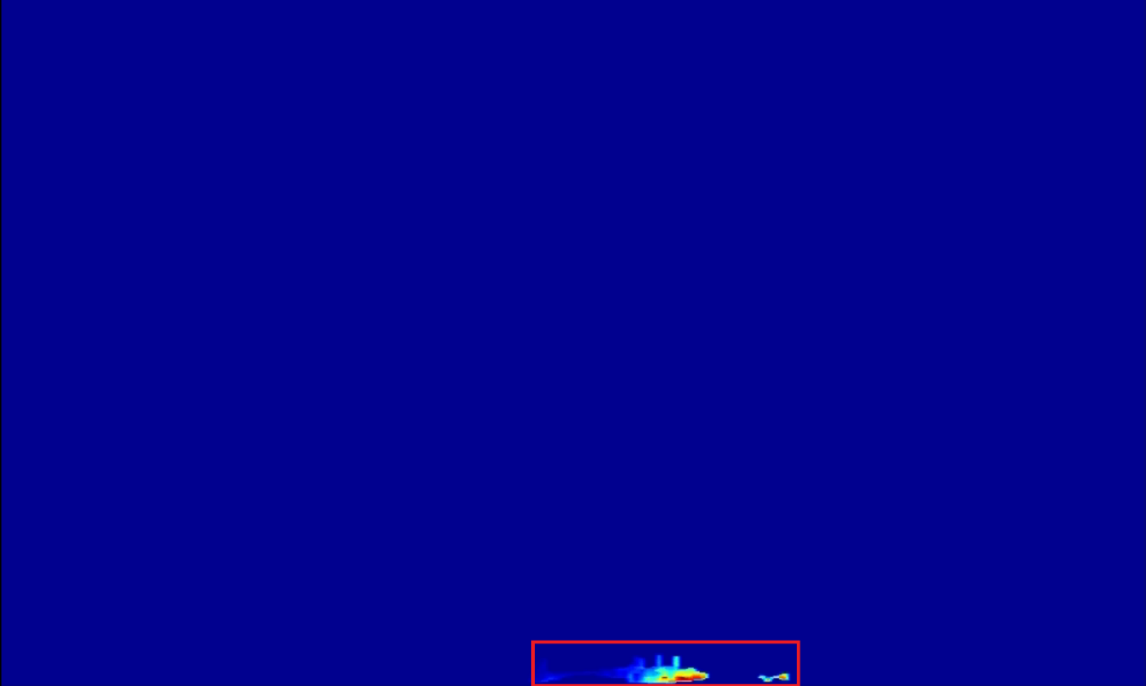
Our Solution
Increase the resolution only around localized area of high residuals

Slide 12
Results
With minimum inflation factor (2), resolution more than doubled
Follows exponential increase in resolution with inflation factor
Computational time minimally increased (< 1%)
Total number of points in subdomain are fewer than global domain.
However, if equal or even larger, the subdomain only runs a single iteration before being copied back to the global mesh for continuation of simulation.

Slide 13
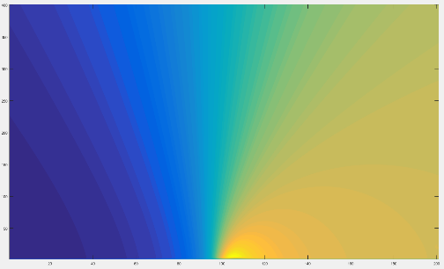
Results
X-velocity contour plot (201x401 or 80,601 nodes)

Slide 14

Results
X-velocity contour plot with subdomain identified.

Slide 15
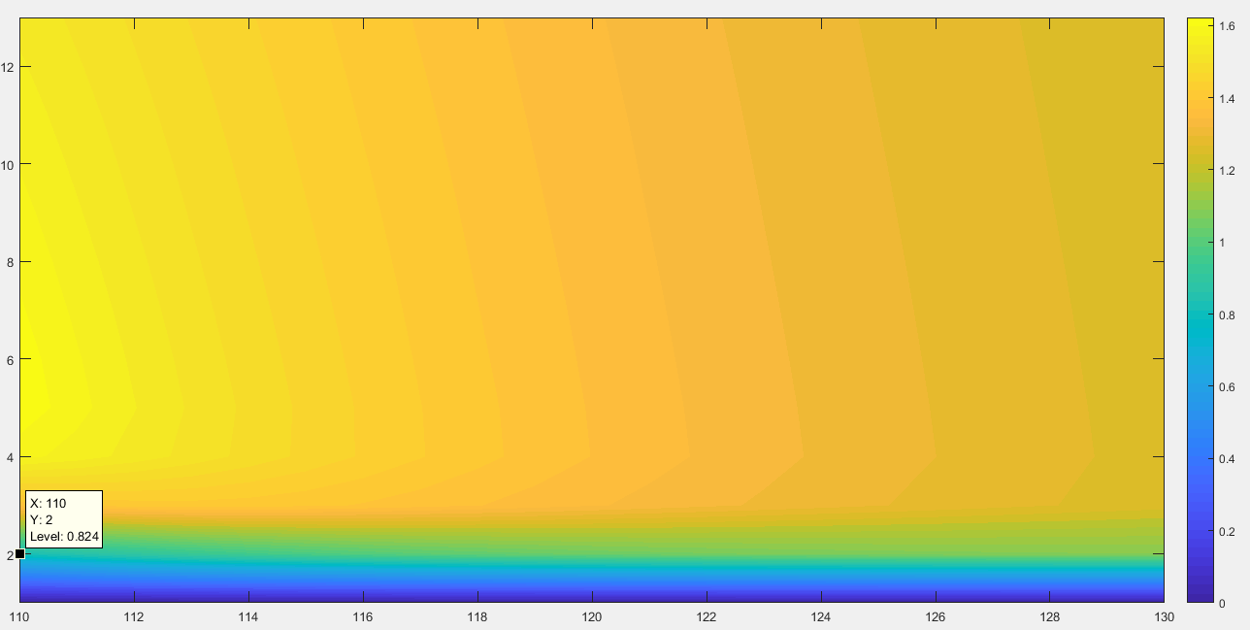
Results
Global x-velocity subdomain (260 nodes or 0.32% of global mesh)

Slide 16
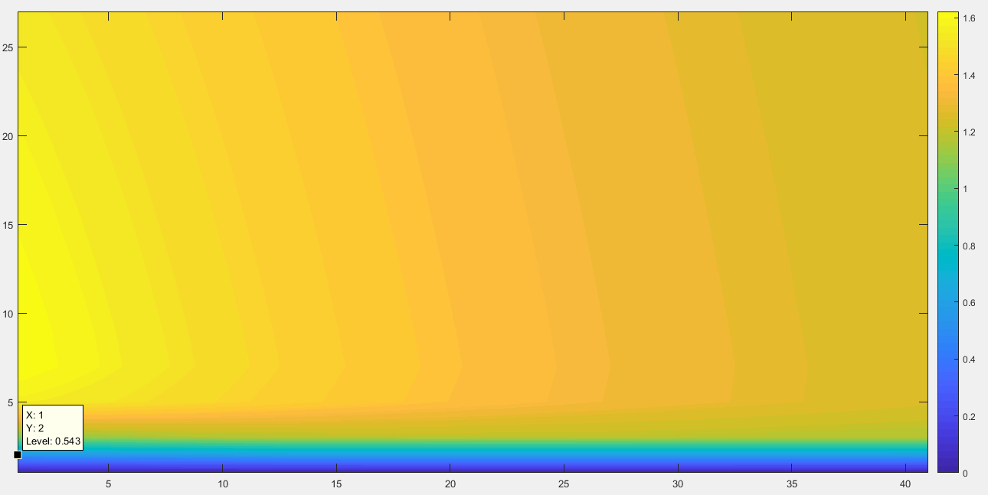
Results
Mesh-refine domain (inflation factor = 2 → 4x nodes, 1,107 nodes or 1.4% of global mesh)

Slide 17
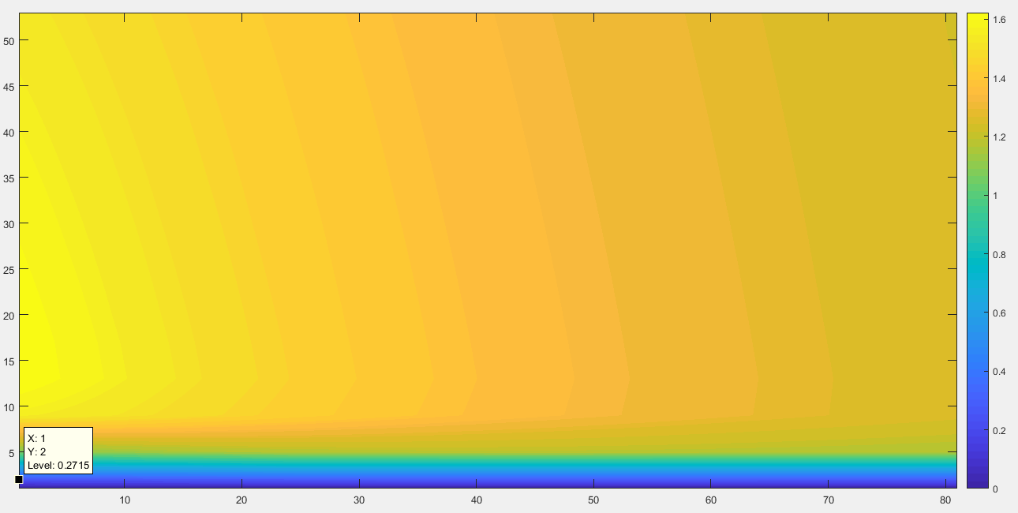
Results
Mesh-refine domain (inflation factor = 4 → 16x nodes, 4,293 nodes or 5.3% of global mesh)

Slide 18
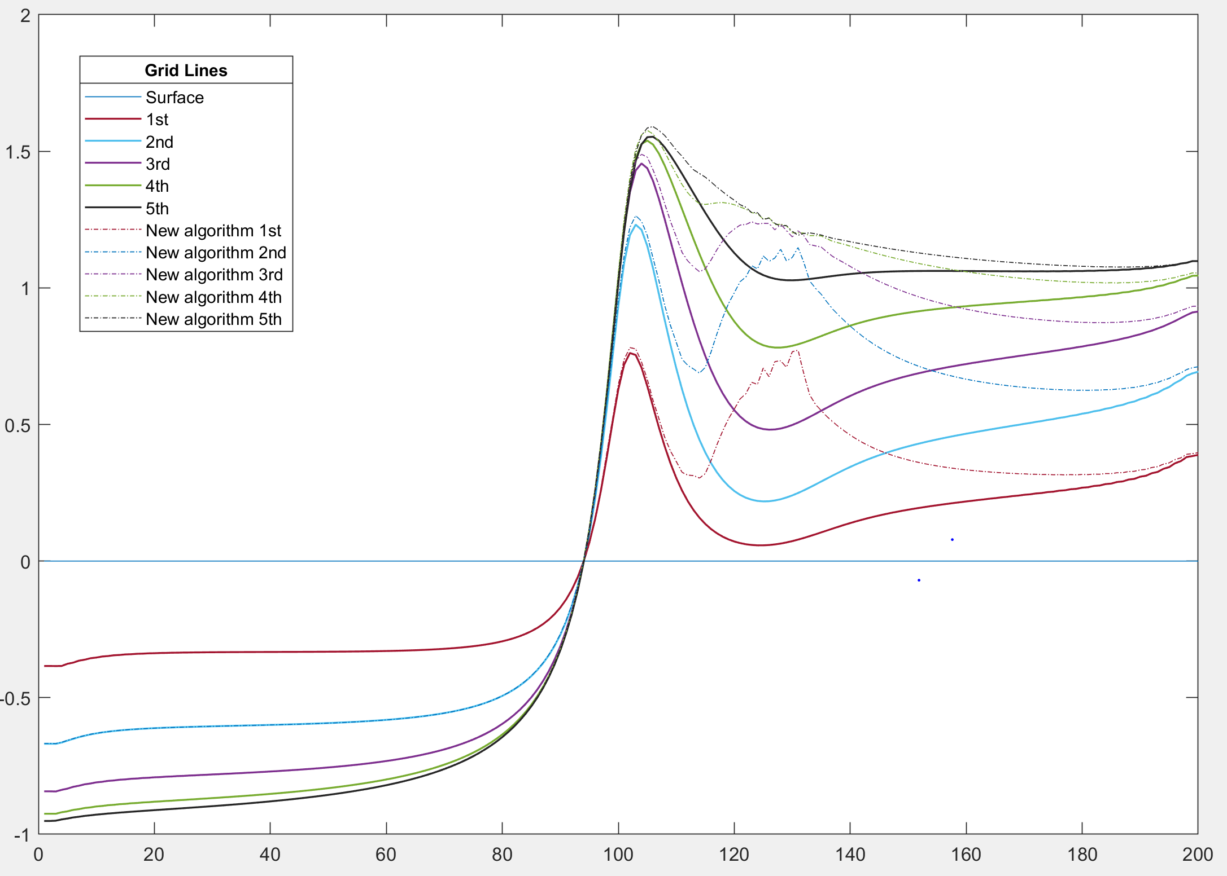
Results
Optimization still remains

Slide 19
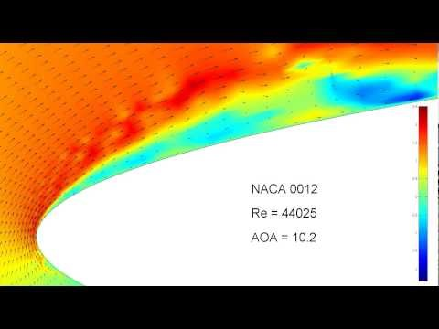
Final Goal
[4]

Slide 20
References
[1] https://www.mathworks.com/matlabcentral/answers/378693-how-to-create-a-non-uniform-2d-grid
[2]https://cubit.sandia.gov/public/14.0/help_manual/WebHelp/mesh_generation/adaptivity_and_sizing_functions/bias_sizing_function.htm
[3] http://ta.twi.tudelft.nl/users/wesselin/projects/unstructured.html
[4] https://www.youtube.com/watch?v=IytDva1y09E

Slide 21
Questions

